Slide 1
SimSpect 1/23/2026

Slide 2








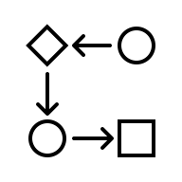







SimSpect final pipeline design
Defense specification
Implementation ISA
Tuning parameters
Defense implementation
Translation to modeling syntax (manual)
Sort into modeling syntax-specific buckets (decide granularity)
Defense-specific choices for expansion priorities
Pass 1: Specify instructions
- Start with speculation primitives, add them to annotation
- Then flesh out other ISA instructions from respective buckets, including xmits, add them to annotation
Consolidate and repeat tests into one large testing program
- Leakage contract
- Exec. contract
- Prot. set
- Prot. mechanism
Pass 2: Add interleave
- Add both on- (ALU) and off-path (any) interleaved instructions, priming downstream state to demonstrate change
m concrete litmus tests (m>>n)
Initial execution model
Defense-specific allowed leakage
Instrument simulator with annotation- and testing program-derived prediction values
- Defense is minimally leaky
- Defense is unique along certain axes
Pass 3: Specify state
- Allocate reg and mem state from allowed list
- Note priming for interleaves
- Floating reg and mem should be unique or shared
n abstract litmus tests
Run test program and inspect instruction order and predictions
Pass 4: Filtration
- Assign some method of prioritization based on including all test cases at a bare minimum, then which ISA instructions to expand upon, then can cut off testing at any point
Litmus test filters
Stage 1: Alloy Analyzer
Stage 2: Python and Java
Stage 3: C++, a bit of python
m speculation annotations

Slide 3
Updates overview
Apple
Bit of a time sink last week, but glad to have the interviews over, they were technical, and also straddled DV and RTL (Sendil, Hangkyu, Johns)
I accepted offer, note to discuss more with you and John Pape or anyone else about the content that does/does not belong to Apple post internship
Mostly not code but the framework of categorizing leakage — I know nothing about IP but since you and Nick came up with that
Coding
Two fronts right now, LLVM register chaos and Gem5 confusion
Even simplest (-o0) LLVM->X86 degrades information I want to fix
Deliverables

Slide 4
Writing deliverables
By Monday 1/26 I will send you the intro, background + related work
By Friday 1/30 I will send you the technical sections
Formal model
Four operative definitions
A chart of how they apply to all our studied defenses
Description of how they work to define violating traces as seen in our execution model
Test generation
Description of Alloy structure
Description of relaxations, framed similarly to Lustig paper

Slide 5
LLVM progress
Different optimization passes:
https://iitd-plos.github.io/col729/labs/lab1/lab1.html
-O0 – no optimization (still does dead code elim, x86 instruction selection, spilling (BAD), stack layout, nops
-O1 – more scheduling
-O2 – for production builds, vectorization and gets rid of variables and code blocks
-O3, -Oz, -Os aggressive, size aggressive, size

Slide 6
LLVM progress
I want to control register allocation so I have to do it manually??
I was reading about forcing certain inline x86 in the LLVM but it still optimizes, I would have to fence
Issue is the spilling and dead code elim
So I have new register algorithm

Slide 7
LLVM progress
Mapping from alloy reg → loc where loc is physical reg like %r12 or else a stack slot [rbp-0x20]
Walk PO, for each instruction
Make sure inputs are in temp phys reg, assign one if needed
Compute result into a temp reg
Wb to dest reg location, FLAG IF SPILL -> that test fails
Maintain freelist of registers (not sure if there’s a way to free them though, the ones that are just allocated for one use should be allowed)
Came to the conclusion that it doesn’t matter if we generate a second violating path so I’m no longer tracking that (chart of second path causing false positive vs adding important information)
Case where both are true
Maintain determinism in ordering

Slide 8
Enumeration questions
Sending complexity back to alloy??? If I constrain registers there and fill each register
I’m also doing a slow alloy debug via manual inspection of identical x86 programs (figuring out how to tell Alloy to ignore certain sigs)

Slide 9
Gem5
Still trying to tinker with the store address predictor
Store_set.cc and store_set.h
It isn’t affecting anything so I’m trying to debug that right now

Slide 10
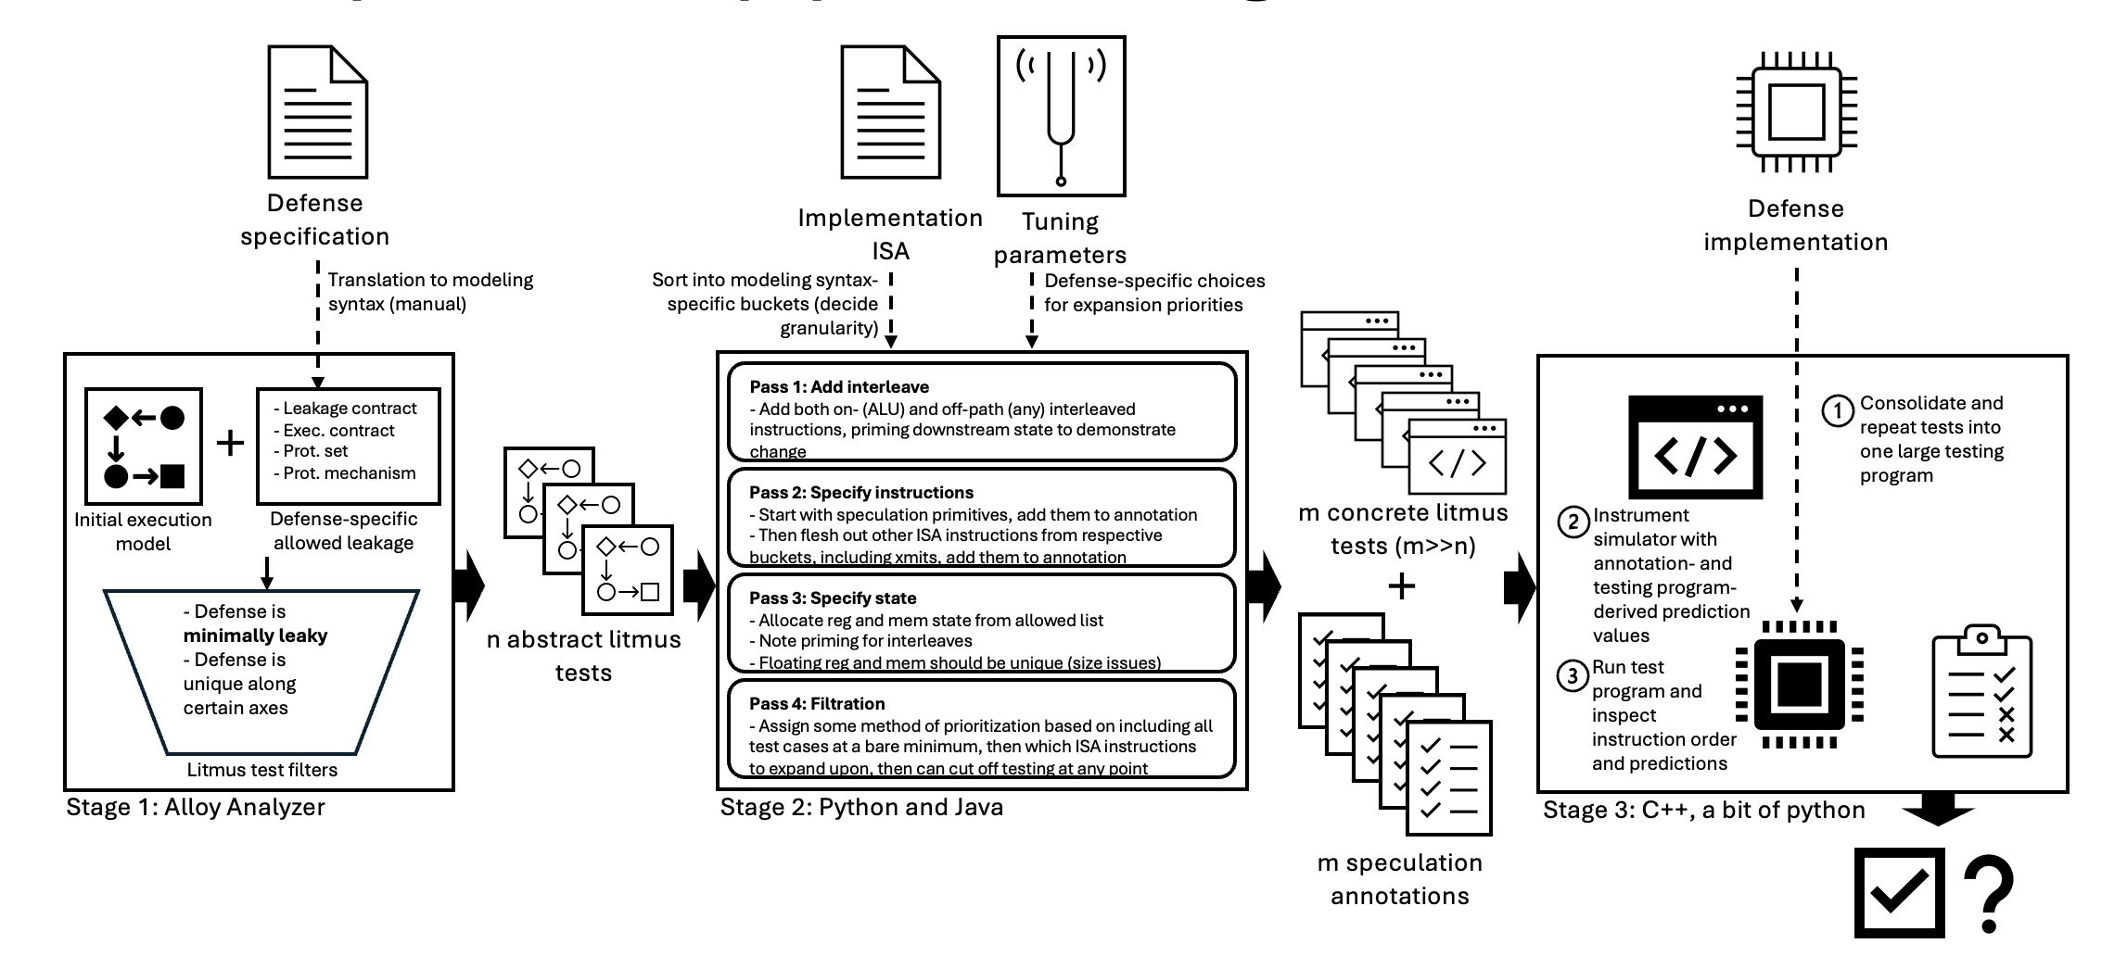

Example
STT (upon commit)
Execution contract:
Speculation = uncommitted
Protection set:
All memory
Leakage function: all load’s addresses
+ branch and other xmit’s inregisters
Protection mechanism (propagation): static

Slide 11

Example
Known bug:
mov a [b]
mov c [a] // committed, unprot [b]
mov a [d] // uncommitted, load a secret
mov e [a] // leak
instructions
operands
state
committed
inaddr
r0
[r0]
r1
[r1]
r2
uncommitted
inmem
load r1 [r0]
Uncommitted, unresolved
load r2 [r1]
Uncommitted, unresolved
outreg
ddi
spo
rf
inaddr
inmem
outreg
Orange is transmitter
Purple protected state

Slide 12

Example
Known bug:
mov a [b]
mov c [a] // committed, unprot [b]
mov a [d] // uncommitted, load a secret
mov e [a] // leak
committed
uncommitted
load r1 [r0] // uncommitted, unresolved
load r2 [r1] // uncommitted, unresolved

Slide 13
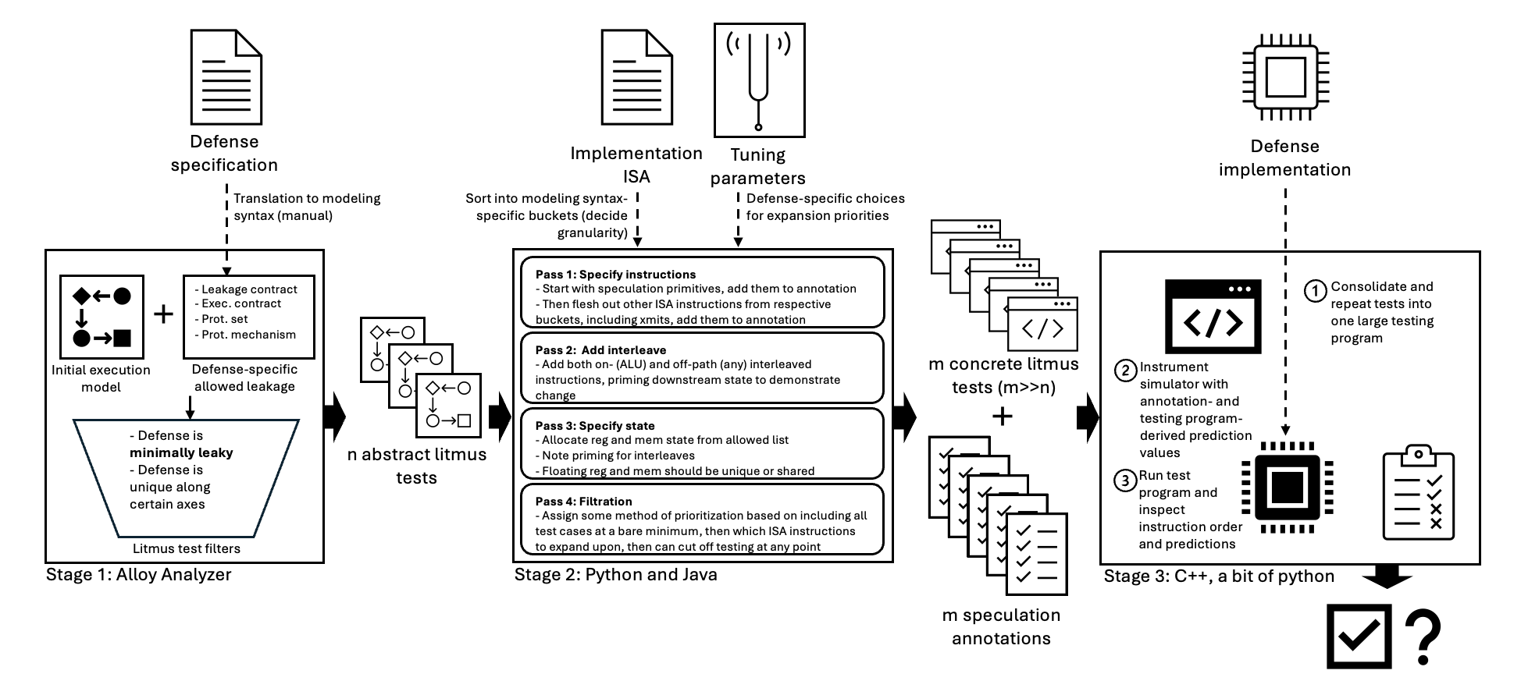

Example
Known bug:
mov a [b]
mov c [a] // committed, unprot [b]
mov a [d] // uncommitted, load a secret
mov e [a] // leak
committed
uncommitted
mov r1 [r0] // uncommitted, unresolved
mov r2 [r1] // uncommitted, unresolved

Slide 14
Example
Known bug:
mov a [b]
mov c [a] // committed, unprot [b]
mov a [d] // uncommitted, load a secret
mov e [a] // leak
committed
uncommitted
mov r1 [r4] // committed, resolved
mov r3 [r1] // committed, resolved
mov r1 [r0] // uncommitted, unresolved
mov r2 [r1] // uncommitted, unresolved

Slide 15
Example
Known bug:
mov a [b]
mov c [a] // committed, unprot [b]
mov a [d] // uncommitted, load a secret
mov e [a] // leak
committed
uncommitted
mov r1 [r4] // committed, resolved
mov r3 [r1] // committed, resolved
mov r1 [r0] // uncommitted, unresolved
mov r2 [r1] // uncommitted, unresolved

Slide 16
Example
Known bug:
mov a [b]
mov c [a] // committed, unprot [b]
mov a [d] // uncommitted, load a secret
mov e [a] // leak
committed
uncommitted
mov r1 [r4] // committed, resolved
mov r3 [r1] // committed, resolved
mov r1 [r0] // uncommitted, unresolved
mov r2 [r1] // uncommitted, unresolved

Slide 17
Example

Slide 18
SimSpect 1/9/2026
Where are we?

Slide 19
SimSpect final pipeline design
Defense specification
Implementation ISA
Tuning parameters
Defense implementation
Translation to modeling syntax (manual)
Sort into modeling syntax-specific buckets (decide granularity)
Defense-specific choices for expansion priorities
Pass 1: Specify instructions
- Start with speculation primitives, add them to annotation
- Then flesh out other ISA instructions from respective buckets, including xmits, add them to annotation
Consolidate and repeat tests into one large testing program
- Leakage contract
- Exec. contract
- Prot. set
- Prot. mechanism
Pass 2: Add interleave
- Add both on- (ALU) and off-path (any) interleaved instructions, priming downstream state to demonstrate change
m concrete litmus tests (m>>n)
Initial execution model
Defense-specific allowed leakage
Instrument simulator with annotation- and testing program-derived prediction values
- Defense is minimally leaky
- Defense is unique along certain axes
Pass 3: Specify state
- Allocate reg and mem state from allowed list
- Note priming for interleaves
- Floating reg and mem should be unique or shared
n abstract litmus tests
Run test program and inspect instruction order and predictions
Pass 4: Filtration
- Assign some method of prioritization based on including all test cases at a bare minimum, then which ISA instructions to expand upon, then can cut off testing at any point
Litmus test filters
Stage 1: Alloy Analyzer
Stage 2: Python and Java
Stage 3: C++, a bit of python
m speculation annotations

Slide 20







Rough progress
Defense specification
Implementation ISA
Tuning parameters
Defense implementation
Translation to modeling syntax (manual)
Sort into modeling syntax-specific buckets (decide granularity)
Defense-specific choices for expansion priorities
Pass 1: Add interleave
- Add both on- (ALU) and off-path (any) interleaved instructions, priming downstream state to demonstrate change
Consolidate and repeat tests into one large testing program
- Leakage contract
- Exec. contract
- Prot. set
- Prot. mechanism
Pass 2: Specify instructions
- Start with speculation primitives, add them to annotation
- Then flesh out other ISA instructions from respective buckets, including xmits, add them to annotation
m concrete litmus tests (m>>n)
Initial execution model
Defense-specific allowed leakage
Instrument simulator with annotation- and testing program-derived prediction values
- Defense is minimally leaky
- Defense is unique along certain axes
Pass 3: Specify state
- Allocate reg and mem state from allowed list
- Note priming for interleaves
- Floating reg and mem should be unique (size issues)
n abstract litmus tests
Run test program and inspect instruction order and predictions
Pass 4: Filtration
- Assign some method of prioritization based on including all test cases at a bare minimum, then which ISA instructions to expand upon, then can cut off testing at any point
Litmus test filters
Stage 1: Alloy Analyzer
Stage 2: Python and Java
Stage 3: C++, a bit of python
m speculation annotations

Slide 21
Design questions
Which ISAs
Which knobs to give to user
Which defenses to test
How to categorize, do we use all instructions
What is model syntax?
Detail handled by protection mechanism
Size of interleaves
Annotation format – to check the correct xmit state later
Number of times to run things
Register list reaching capacity (eg instr execution of len 5, + 2 interleave can deal with 21 registers)
How to add relevant state without messing up leakage flow?
Which dimensions to relax along, because not everything must be minimal, interesting compound cases?
Cache initial state
Order of enumeration passes?
Prioritization ranking? Iterate through abstract tests starting with a few of each, then prioritize other copies lower?
Register and memory domains
Limit to transmitters we can track? No because not like AMuLeT
Enumeration-domain symmetry breaking – which axes do we care about
Model-domain symmetry breaking – which axes do we care about

Slide 22
Design questions
Stage 1:
Model syntax
Which defenses to test
Detail of protection mechanism
Relaxation dimensions, compound minimal cases?
Model-domain symmetry breaking
Stage 2:
Which ISAs to support
How to categorize instructions, leave any out?
Which knobs to give a user
Order of the enumeration passes
Size of interleaves
How to add relevant state without messing up leakage flow
Annotation format compatible with later probing
Register list capacity if everything is unconstrained (don’t want extra dependencies)
Test prioritization after the fact
Repetitive tests (through multiple forms of modification converging)
Stage 3:
Register and memory domains
Cache initial state
Number of times to run things
Notes:
These are all design decisions we are making
Most of them figured out, but I want to be able to defend why we did each thing in the paper or if someone asks

Slide 23
Design questions
Stage 1:
Model syntax
Which defenses to test
Detail of protection mechanism (incl committed) (Protean complication)
Relaxation dimensions, compound minimal cases? ???
Model-domain symmetry breaking
Stage 2:
Which ISAs to support - x86
How to categorize instructions, leave any out?
Which knobs to give a user
Order of the enumeration passes – I think this is fixed
Size of interleaves
How to add relevant state without messing up leakage flow (recalculating flow)
Annotation format compatible with later probing – I think done
Register list capacity if everything is unconstrained (don’t want extra dependencies)
Test prioritization after the fact
Repetitive tests (through multiple forms of modification converging) I think I designed so this won’t happen
Stage 3:
Register and memory domains
Cache initial state
Number of times to run things
Notes:
These are all design decisions we are making
Most of them figured out, but I want to be able to defend why we did each thing in the paper or if someone asks

Slide 24
Model
Nodes:
Instructions:
Xmit
Ld
Str
Br
other
Non-xmit
Br
other
State: reg, mem
Booleans:
Committed (out of ROB, non-spec)
Contiguous at end of SPO
Resolved
Br knows target and condition
Ld str know addr
Edges:
Ordering
Po: i->i
Spo: i->i
Rf, ddi: i->i
Labeling
In_addr, in_reg, in_mem, out_reg, out_mem: i->state
Bool: i->bool
Relaxations
Remove instruction
Remove operand
Remove committed
Remove resolved

Slide 25
Defenses
All implemented stage 1 except Protean, how to represent forced protsets from compiler with only an update rule?
Mostly just using STT and NDA for stage 2 initial testing, but should be generally applicable, except need to specify tuning parameters
STT [Yu+, MICRO ’19]
SpecShield [Barber+, PACT ’19]
NDA [Weisse+, MICRO ’19]
Delay-on-Miss [Sakalis+, ISCA ’19]
SDO [Yu+, ISCA ’20]
SPT [Choudhary+, MICRO ’21]
Recon [Aimoniotus+, MICRO ’23]
Doppelgänger loads [Kvalsvik+, ISCA ’23]
Protean
Amulet tests:
InvisiSpec, CleanupSpec, STT, and SpecLFB
STT prog size | Tests
2 | None
3 | 72
4 | 132
5 | 210

Slide 26
Other things
Updates:
Got rid of json factoring, I just have a model for each thing, could allow me to add more custom relaxations down the line if necessary
Had to go back to the hacky propagation again
secret set in the presentation
Have some good figures coming up
Writing, made progress on intro and started some of the technical sections. Can I send you an intro draft soon
Apple final round Monday
Good talk with Jon Tyler about test design for HSCs
Notes:
In order commits changing prot set in different order

Slide 27
Example
STT (upon commit)
Execution contract:
Speculation = uncommitted
Protection set:
All memory
Leakage function: all load’s addresses
+ branch and other xmit’s inregisters
Protection mechanism (propagation): static except committed loads unprotect their address in

Slide 28
Example
Known bug:
mov a [b]
mov c [a] // committed, unprot [b]
mov a [d] // uncommitted, load a secret
mov e [a] // leak
instructions
operands
state
committed
inaddr
r0
[r0]
r1
[r1]
r2
uncommitted
inmem
load r1 [r0]
Uncommitted, unresolved
load r2 [r1]
Uncommitted, unresolved
outreg
ddi
spo
rf
inaddr
inmem
outreg
Orange is transmitter
Purple protected state

Slide 29
Example
Known bug:
mov a [b]
mov c [a] // committed, unprot [b]
mov a [d] // uncommitted, load a secret
mov e [a] // leak
committed
uncommitted
load r1 [r0] // uncommitted, unresolved
load r2 [r1] // uncommitted, unresolved

Slide 30
Example
Known bug:
mov a [b]
mov c [a] // committed, unprot [b]
mov a [d] // uncommitted, load a secret
mov e [a] // leak
committed
uncommitted
mov r1 [r0] // uncommitted, unresolved
mov r2 [r1] // uncommitted, unresolved

Slide 31
Example
Known bug:
mov a [b]
mov c [a] // committed, unprot [b]
mov a [d] // uncommitted, load a secret
mov e [a] // leak
committed
uncommitted
mov r1 [r4] // committed, resolved
mov r3 [r1] // committed, resolved
mov r1 [r0] // uncommitted, unresolved
mov r2 [r1] // uncommitted, unresolved

Slide 32
Example
Known bug:
mov a [b]
mov c [a] // committed, unprot [b]
mov a [d] // uncommitted, load a secret
mov e [a] // leak
committed
uncommitted
mov r1 [r4] // committed, resolved
mov r3 [r1] // committed, resolved
mov r1 [r0] // uncommitted, unresolved
mov r2 [r1] // uncommitted, unresolved

Slide 33
Example
Known bug:
mov a [b]
mov c [a] // committed, unprot [b]
mov a [d] // uncommitted, load a secret
mov e [a] // leak
committed
uncommitted
mov r1 [r4] // committed, resolved
mov r3 [r1] // committed, resolved
mov r1 [r0] // uncommitted, unresolved
mov r2 [r1] // uncommitted, unresolved

Slide 34
SimSpect final pipeline design
Defense specification
Implementation ISA
Tuning parameters
Defense implementation
Translation to modeling syntax (manual)
Sort into modeling syntax-specific buckets (decide granularity)
Defense-specific choices for expansion priorities
Pass 1: Add interleave
- Add both on- (ALU) and off-path (any) interleaved instructions, priming downstream state to demonstrate change
Consolidate and repeat tests into one large testing program
- Leakage contract
- Exec. contract
- Prot. set
- Prot. mechanism
Pass 2: Specify instructions
- Start with speculation primitives, add them to annotation
- Then flesh out other ISA instructions from respective buckets, including xmits, add them to annotation
m concrete litmus tests (m>>n)
Initial execution model
Defense-specific allowed leakage
Instrument simulator with annotation- and testing program-derived prediction values
- Defense is minimally leaky
- Defense is unique along certain axes
Pass 3: Specify state
- Allocate reg and mem state from allowed list
- Note priming for interleaves
- Floating reg and mem should be unique (size issues)
n abstract litmus tests
Run test program and inspect instruction order and predictions
Pass 4: Filtration
- Assign some method of prioritization based on including all test cases at a bare minimum, then which ISA instructions to expand upon, then can cut off testing at any point
Litmus test filters
Stage 1: Alloy Analyzer
Stage 2: Python and Java
Stage 3: C++, a bit of python
m speculation annotations

Slide 35
SimSpect final pipeline design
Defense specification
Implementation ISA
Tuning parameters
Defense implementation
Translation to modeling syntax (manual)
Sort into modeling syntax-specific buckets (decide granularity)
Defense-specific choices for expansion priorities
Pass 1: Specify instructions
- Start with speculation primitives, add them to annotation
- Then flesh out other ISA instructions from respective buckets, including xmits, add them to annotation
Consolidate and repeat tests into one large testing program
- Leakage contract
- Exec. contract
- Prot. set
- Prot. mechanism
Pass 2: Add interleave
- Add both on- (ALU) and off-path (any) interleaved instructions, priming downstream state to demonstrate change
m concrete litmus tests (m>>n)
Initial execution model
Defense-specific allowed leakage
Instrument simulator with annotation- and testing program-derived prediction values
- Defense is minimally leaky
- Defense is unique along certain axes
Pass 3: Specify state
- Allocate reg and mem state from allowed list
- Note priming for interleaves
- Floating reg and mem should be unique or shared
n abstract litmus tests
Run test program and inspect instruction order and predictions
Pass 4: Filtration
- Assign some method of prioritization based on including all test cases at a bare minimum, then which ISA instructions to expand upon, then can cut off testing at any point
Litmus test filters
Stage 1: Alloy Analyzer
Stage 2: Python and Java
Stage 3: C++, a bit of python
m speculation annotations

